Slide 1


Case Study
Road Ready
Krishna T
Java + Angular FSD Batch-2

Slide 2
Project Overview
Project Name: RoadReady
Type: Car booking & rental management system
Architecture: Spring Boot RESTful Web Service
Goal: Enable user registration, car bookings, payments, and admin management

Slide 3
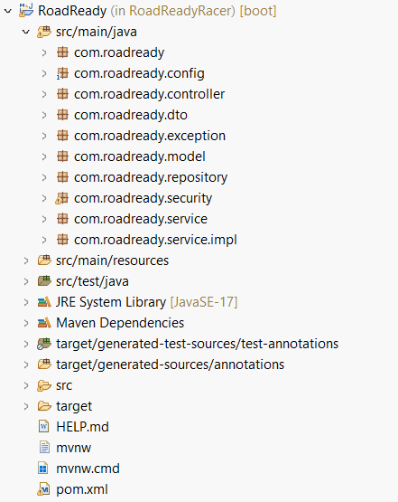
Project Structure

Slide 4
Tech Stack
Backend: Java 17, Spring Boot
Database: MySQL
Security: Spring Security with JWT
API Docs: Swagger (OpenAPI)
Build Tool: Maven

Slide 5
Key Functionalities
User Authentication: Register/Login (JWT)
Admin Capabilities: Manage cars, view bookings
Booking System: Create, view, and manage bookings
Payment Integration: Handle and store payment info
Review System: Submit and fetch car reviews

Slide 6
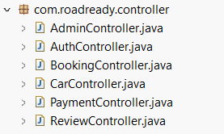
Controllers
AuthController: Register and login
AdminController: Admin operations
CarController: Add, list, manage cars
BookingController: Book car, cancel, get bookings
PaymentController: Handle payments
ReviewController: Manage user reviews

Slide 7

DTOs
LoginDTO: User login details
UserDTO: Registration input
AuthResponse: JWT + user info response

Slide 8
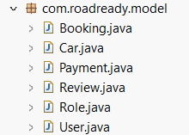
Models
User: Authenticated user details
Car: Car listing with specs
Booking: User-car booking record
Payment: Booking payment details
Review: Car reviews and ratings

Slide 9

Security Layer
JWT Authentication Filter
Password encoding using BCrypt
Role-based access (User/Admin)
Token validation per request

Slide 10
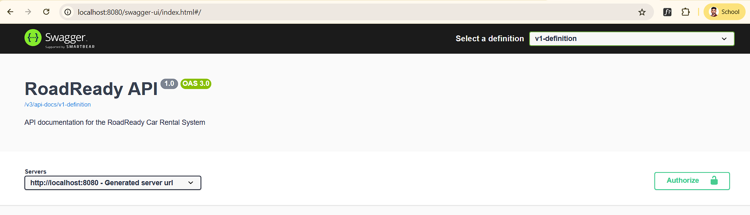
Swagger Integration
API documentation available at /swagger-ui.html
Organized per controller
Used for testing and exploring endpoints

Slide 11
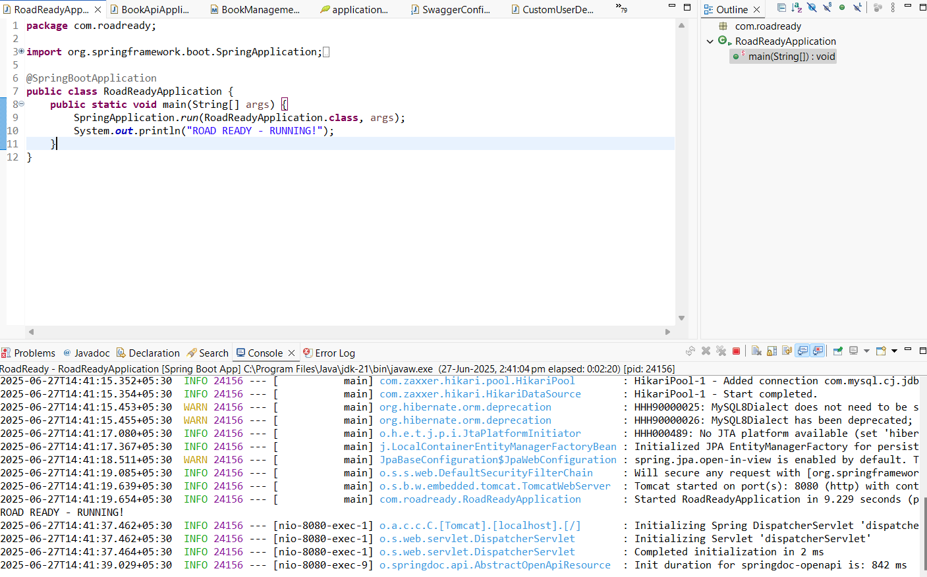
Project Output
Running Success

Slide 12
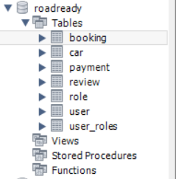
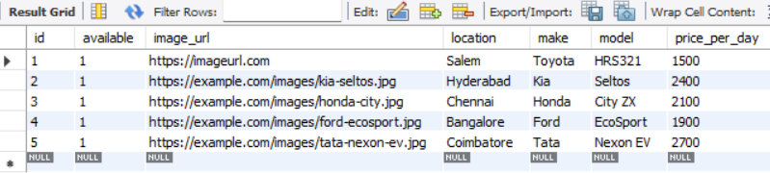
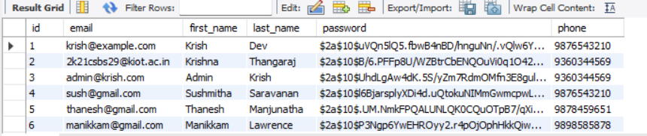
MySQL Database
Database created “roadready.”

Slide 13
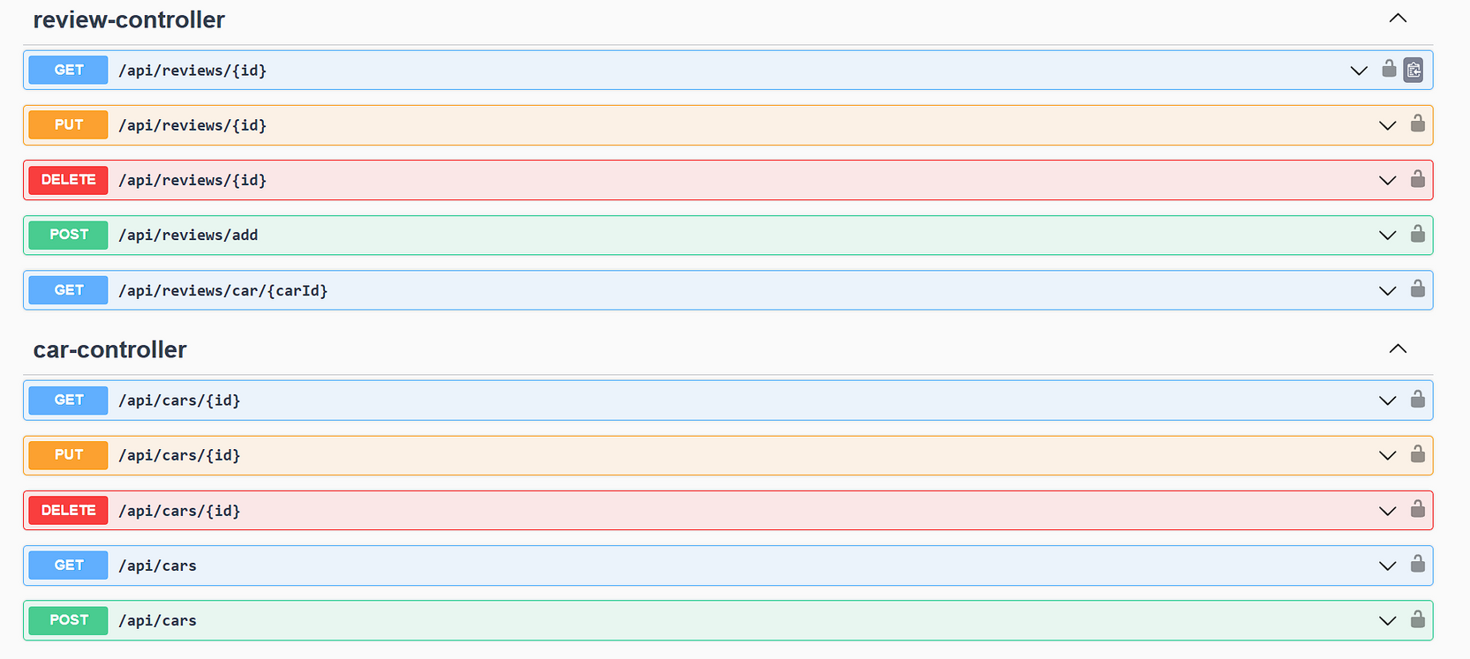
Swagger API
Review & Car

Slide 14
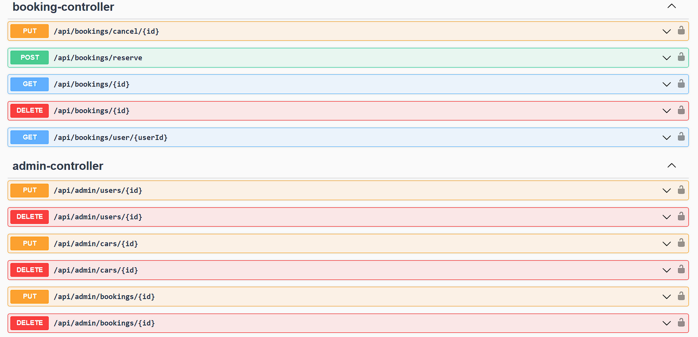
Swagger API
Booking & Admin

Slide 15
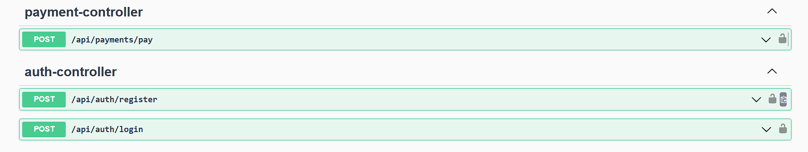
Swagger API
Payment & Author

Slide 16
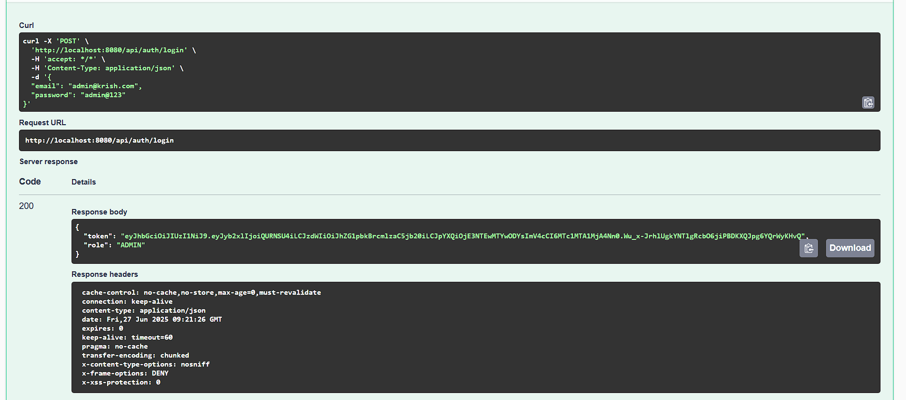
Register & Login
Admin Login Successful

Slide 17
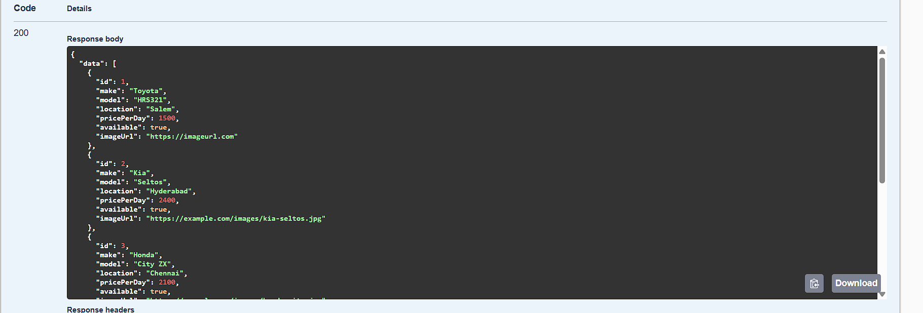
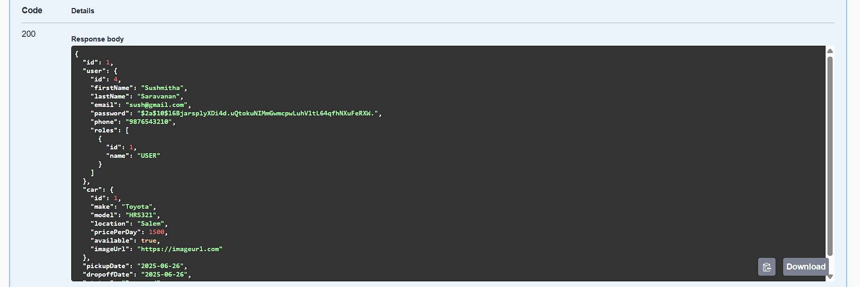
Cars & Booking
Available Cars & Booking Data

Slide 18
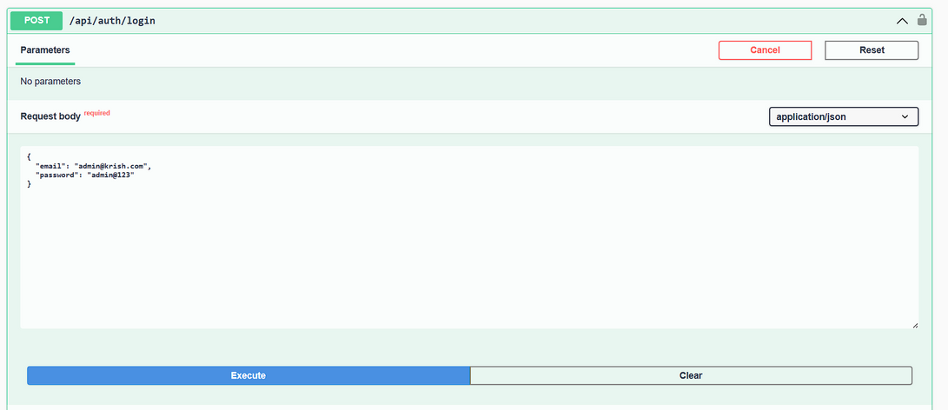
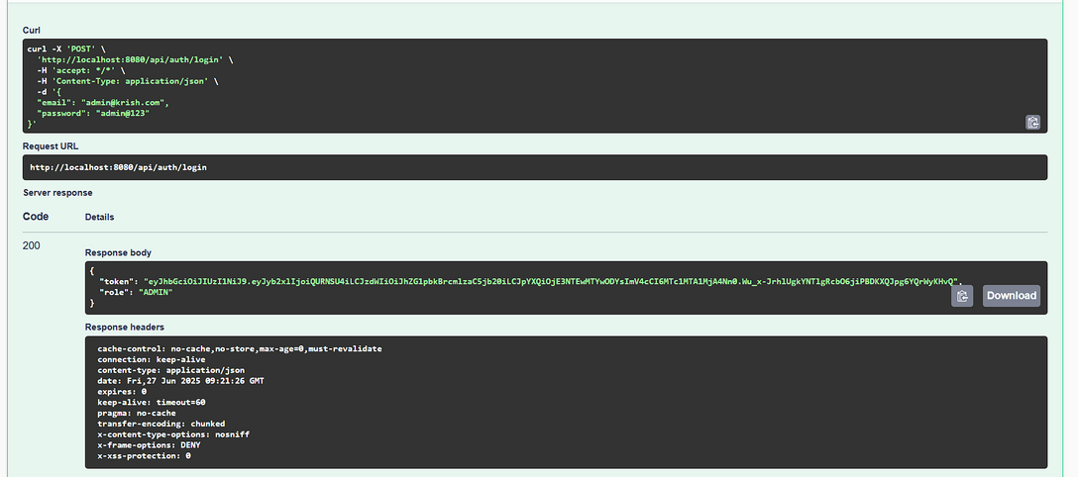
Register & Login
Admin Login Successful

